Slide 1
COMPUTER AIDED DESIGN AND DRAFTING
OBE Final Assignment On

Slide 2
Presented By
Md Sadi Al Huda : 20-43129-1
Md Tayebuzzaman Siddique : 18-38376-2
Tasnim Jahan : 17-33455-1
Minhazul Islam : 17-34958-2
Nissan Bin Sharif : 20-44351-3

Slide 3
What is AutoCAD?
AutoCAD is a computer aided design drafting software program. It is used for creating blueprints for buildings, bridges, computer chips, electric design etc. The meaning of CAD is Computer Aided Design.
AutoCAD invented on 1982.
There are total 4 workspaces on AutoCAD
AutoCAD graphics Window is 12”x9”
The extension of a saved AutoCAD file is .dwg

Slide 4
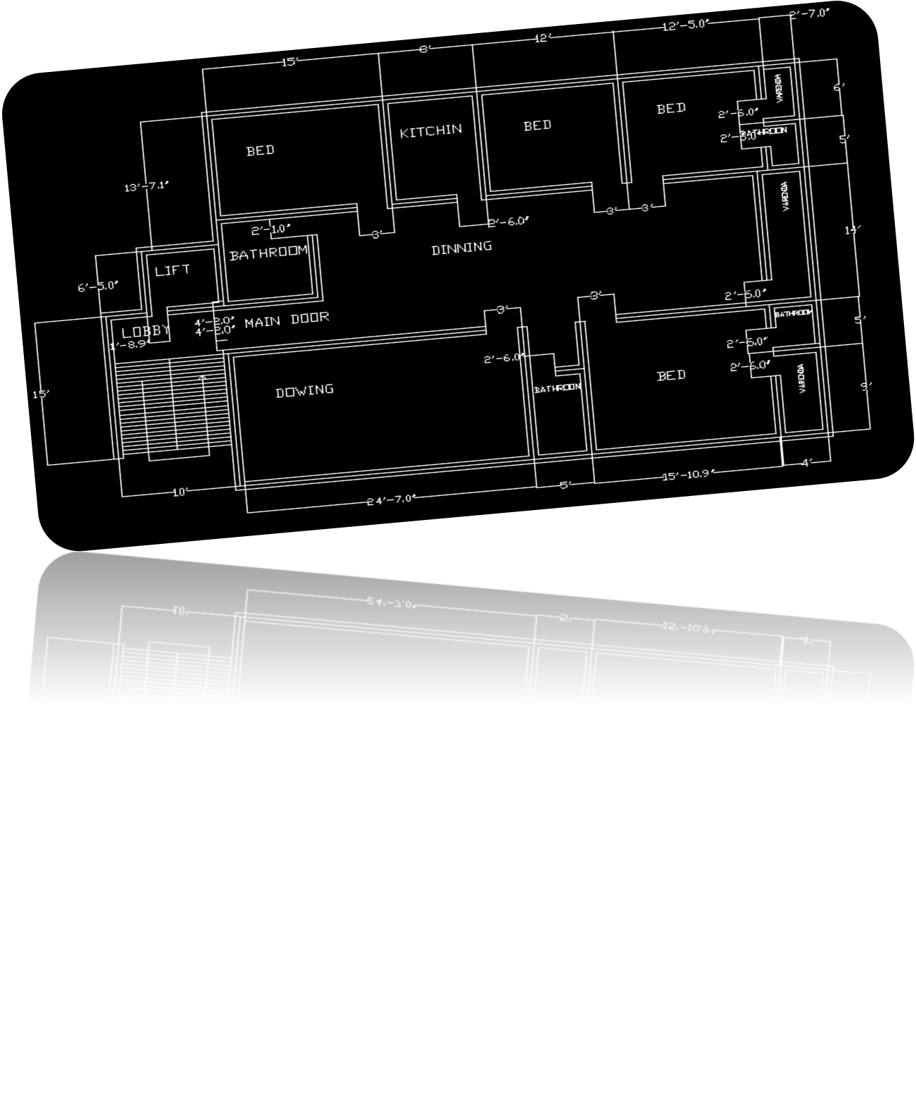
Planning Design

Slide 5
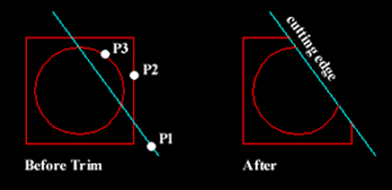
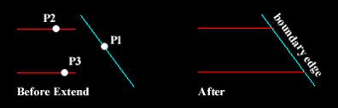
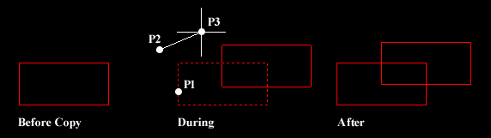
Some AutoCAD commands
TRIM Command
EXTEND Command
Multiple copy Command
HATCH Command
PURGE Command
DI/ Distance Command
ARRAY Command
REVCLOUD Command
OOPS Command
BREAK Command
QSELECT Command
COPYBASE Command
DIM Command

Slide 6
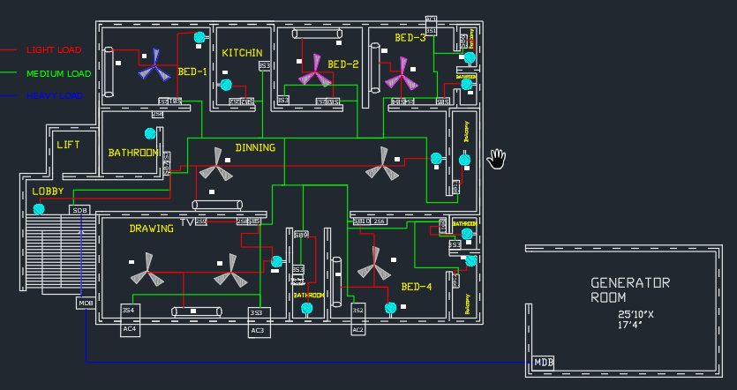
Final Design

Slide 7
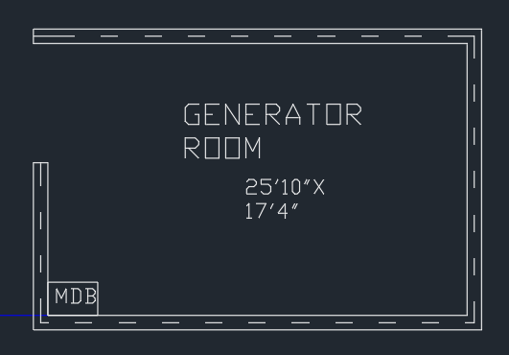
Generator
Power Consumption from:
Bed-1 = 540 WATT
Bed-2 = 1510 WATT
Bed-3 = 1710 WATT
Bed-4 = 1740 WATT
Dining Room = 610 WATT
Drawing Room = 2810 WATT
Verandas = 690
Kitchen = 1430
Bathroom = 2920 WATT
So, Total Power Consumption = 13960 WATT
Generator Capacity = 25000 WATT

Slide 8
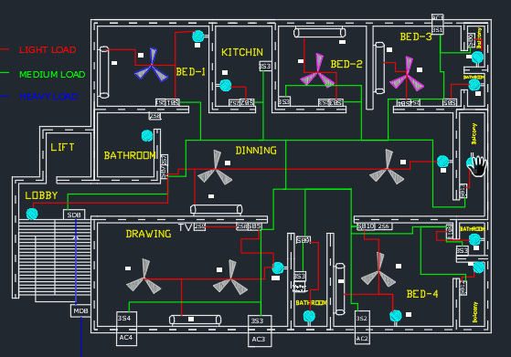
Wiring
In this design we have used 3 types of load for proper power distribution.
We have used Light load, Medium load and Heavy load to wire properly throughout the apartment.
To identify the difference we use 3 different color, such as:
RED = Light Load
Green = Medium Load
Blue = Heavy Load

Slide 9
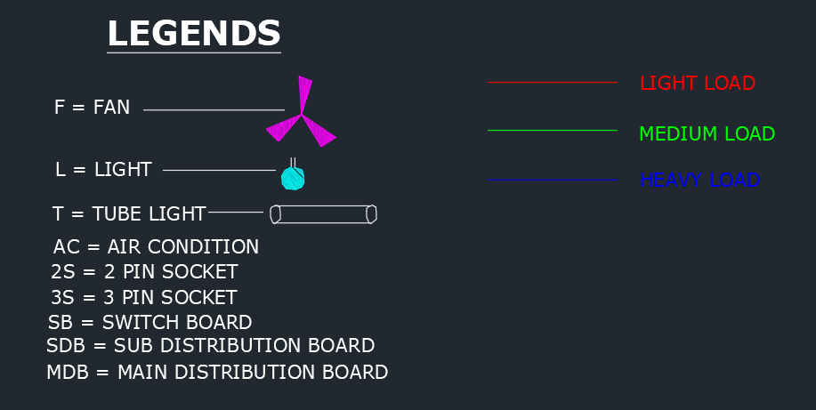
Power distribution
Here is the Legends to identify every objects throughout the flat. In this design we have used 3 types of load for proper power distribution.
Every room has light, fan, tube light and ac. These are connected though wire with the 2S, 3S and switch boards.

Slide 10
Load Calculation
Room | Light | Fan | Tube Light | 2S | SB | 3S(AC) | Total
Bed 1 | 1=30W | 1=70W | 1=40W | 1=200W | 1=200W |  | 540W
Bed 2 |  | 1=70W | 1=40W | 1=200W | 1=200W | 1=1000W | 1510W
Bed 3 |  | 1=70W | 1=40W | 1=200W | 2=400W | 1=1000W | 1710W
Bed 4 | 1=30W | 1=70W | 1=40W | 1=200W | 2=400W | 1=1000W | 1740W
Dining Room | 1=30W | 2=140W | 1=40W | 1=200W | 1=200W |  | 610W
Drawing Room | 1=30W | 2=140W | 1=40W | 2=400W | 1=200W | 2=2000W | 2810W
Kitchen | 1=30W |  |  | 1=200W | 1=200W | 1=1000W | 1430W
Veranda X3 | 1X3=90W |  |  |  | 1X3=600W |  | 690W
BathroomX4 | 1X4=120W |  |  |  | 1X4=800W | 2=2000W | 2920W

Slide 11
Some Uses Of AutoCAD
Engineering Drafting Tool. AutoCAD has the possibility to produce very accurate designs.
Architectural Planning Tool.
3D Printing.
3d Basics.
3d Modeling.
Drafting.
Fashion Industry.
Mechanical Industry.

Slide 12
Conclusion
AutoCAD is a computer-aided design software developed by the company Autodesk . It allows you to draw and edit digital 2D and 3D designs more quickly and easily than you could by hand. The files can also be easily saved and stored in the cloud, so they be accessed anywhere at any time .

Slide 13
Research on topic
Link: https://www.firstfloorplan.com/2020/02/house-plans-two-units-1500-to-2000-3-4-5-decimal.html#gsc.tab=0
First Floor Plan
Design Basis LLC

Slide 14
Thank You!

